Slide 1
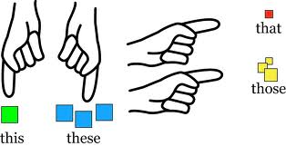
Demonstrative Nouns & Adjectives
© Jenny C. La 2013. This, That, These, Those Lesson and Quiz.

Slide 2
Demonstratives are used to identify or point out a particular item or items (people, things, places, animals) in reference to the speaker.
Here (Near Speaker)
There (Far from Speaker)
© Jenny C. La 2013. This, That, These, Those Lesson and Quiz.

Slide 3


THIS
THIS refers to a singular noun (person, thing, place or animal) near the speaker.
Pronoun example: This is my baby.
Adjective example: This car is pink.
Speaker
© Jenny C. La 2013. This, That, These, Those Lesson and Quiz.

Slide 4
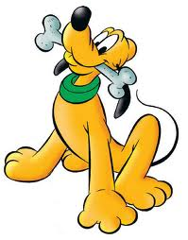

THAT
THAT refers to a singular noun (person, thing, place or animal) far away from the speaker.
Pronoun example: That is our dog over there.
Adjective example: That bus is full.
Speaker
© Jenny C. La 2013. This, That, These, Those Lesson and Quiz.

Slide 5


THESE
THESE refers to plural nouns (people, things, places or animals) near the speaker.
Pronoun example: These are not my kids.
Adjective example: These books are interesting.
Speaker
© Jenny C. La 2013. This, That, These, Those Lesson and Quiz.

Slide 6

THOSE
THOSE refers to plural nouns (people, things, places or animals) far away from the speaker.
Pronoun example: Those are workers on strike over there.
Adjective example: Those people are angry.
Speaker
© Jenny C. La 2013. This, That, These, Those Lesson and Quiz.

Slide 7
Summary of Rules
 | Nouns NEAR you/speaker: Here | Nouns FAR from you/speaker: There
SINGULAR Nouns: | ? | ?
PLURAL Nouns: | ? | ?
© Jenny C. La 2013. This, That, These, Those Lesson and Quiz.

Slide 8
 | Nouns NEAR you/speaker: Here | Nouns FAR from you/speaker: There
SINGULAR Nouns: | THIS (singular noun + near) | THAT (singular noun + far)
PLURAL Nouns: | THESE (plural noun + near) | THOSE (plural noun + far)
Here (Near Speaker)
There (Far from Speaker)
© Jenny C. La 2013. This, That, These, Those Lesson and Quiz.

Slide 9
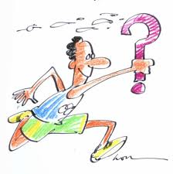

Ready for a Quiz?
Go!
© Jenny C. La 2013. This, That, These, Those Lesson and Quiz.

Slide 10
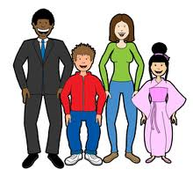

Speaker
Ted David Gloria Lisa
1. _____ is my friend Ted.
This
That
a
c
These
Those
b
d
© Jenny C. La 2013. This, That, These, Those Lesson and Quiz.

Slide 11
Speaker
Ted David Gloria Lisa
1. This is my friend Ted. (singular + near)
√
This
That
a
c
These
Those
b
d
© Jenny C. La 2013. This, That, These, Those Lesson and Quiz.

Slide 12
Speaker
Ted David Gloria Lisa
2. _____ is my friend Lisa.
This
That
a
c
These
Those
b
d
© Jenny C. La 2013. This, That, These, Those Lesson and Quiz.

Slide 13
Speaker
Ted David Gloria Lisa
2. That is my friend Lisa. (singular + far)
√
This
That
a
c
These
Those
b
d
© Jenny C. La 2013. This, That, These, Those Lesson and Quiz.

Slide 14
Speaker
Ted David Gloria Lisa
3. _____ are my friends Ted and David.
This
That
a
c
These
Those
b
d
© Jenny C. La 2013. This, That, These, Those Lesson and Quiz.

Slide 15
Speaker
Ted David Gloria Lisa
3. These are my friends Ted and David. (plural + near)
This
That
a
c
√
These
Those
b
d
© Jenny C. La 2013. This, That, These, Those Lesson and Quiz.

Slide 16
Speaker
Ted David Gloria Lisa
4. _____ are my friends Gloria and Lisa.
This
That
a
c
These
Those
b
d
© Jenny C. La 2013. This, That, These, Those Lesson and Quiz.

Slide 17
Speaker
Ted David Gloria Lisa
4. Those are my friends Gloria and Lisa. (plural + far)
This
That
a
c
These
√
Those
b
d
© Jenny C. La 2013. This, That, These, Those Lesson and Quiz.

Slide 18

Homework
Practise online exercises at:
www.azargrammar.com
© Jenny C. La 2013. This, That, These, Those Lesson and Quiz.

Slide 19
PowerPoint with Voice Narration: Brain Shark
You can view this PowerPoint presentation on Brain Shark
to hear voice narration:
http://my.brainshark.com/This-That-These-Those-Demonstratives-PowerPt-by-Jenny-La-224421735

